Slide 1

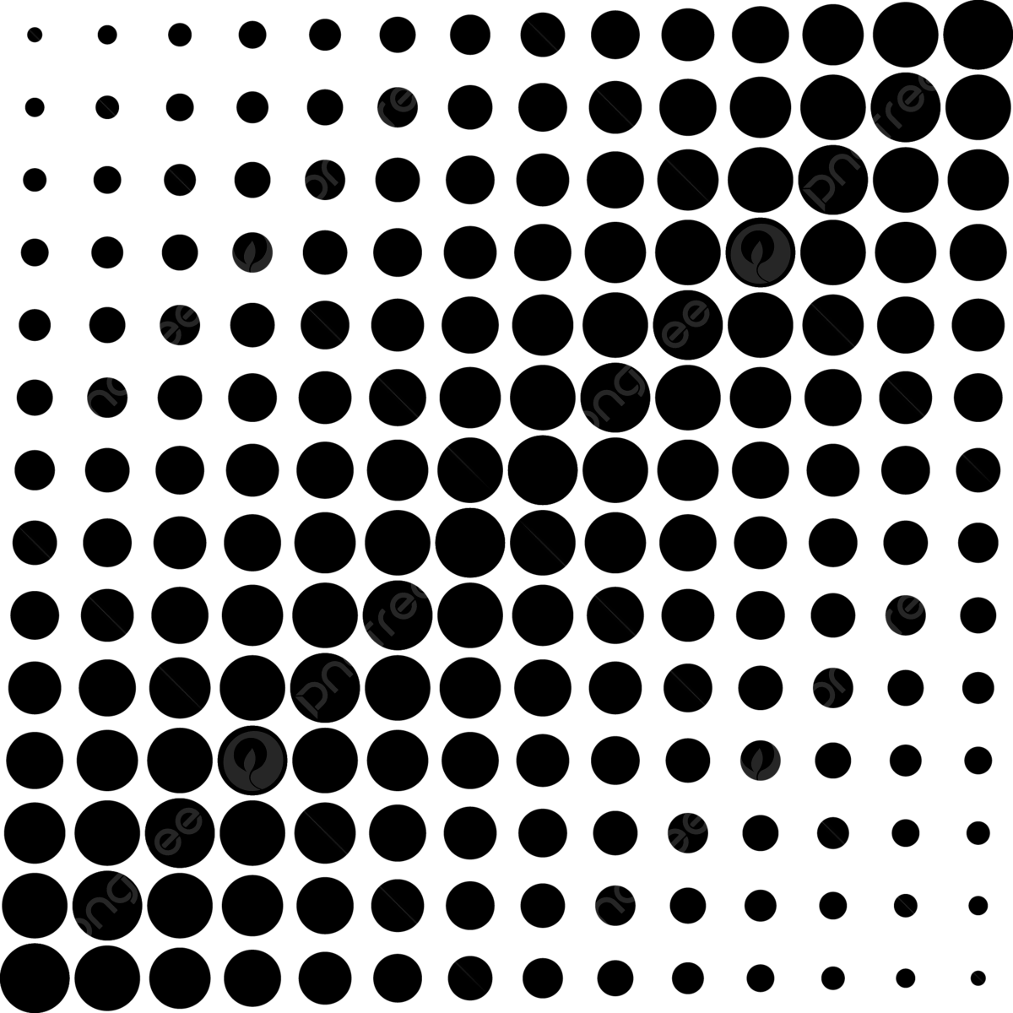

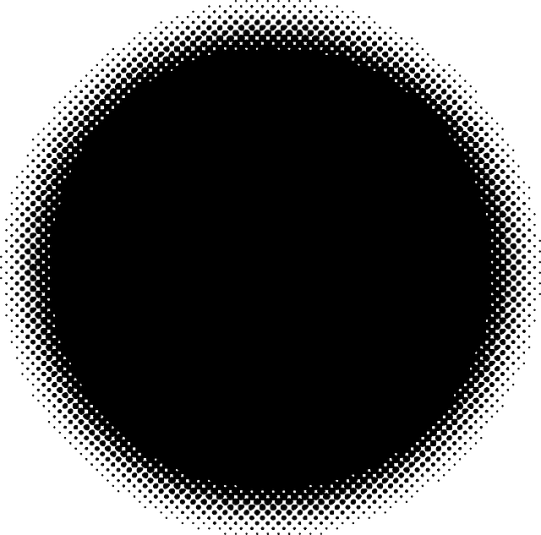


Slide 2
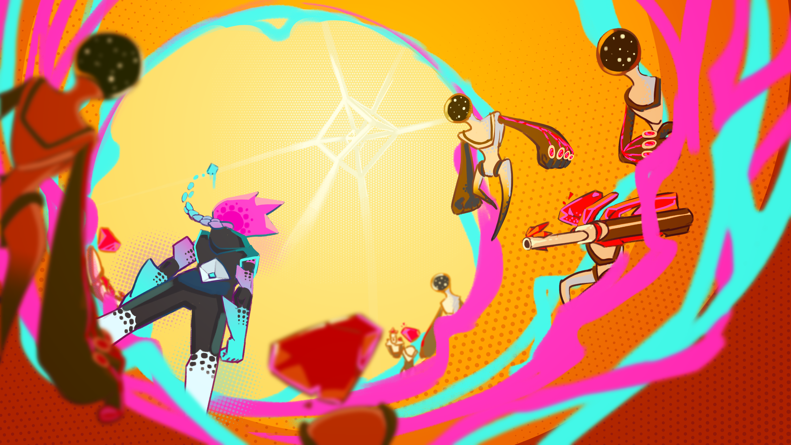


Slide 3
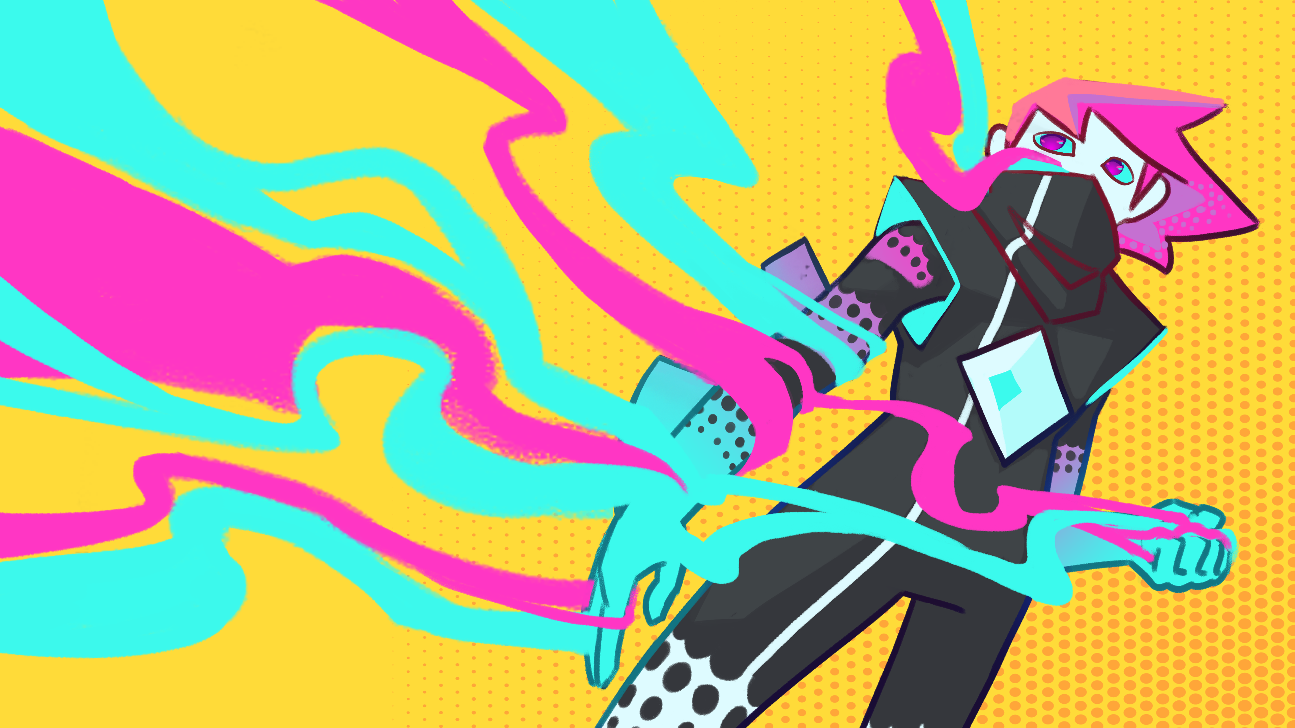


Slide 4
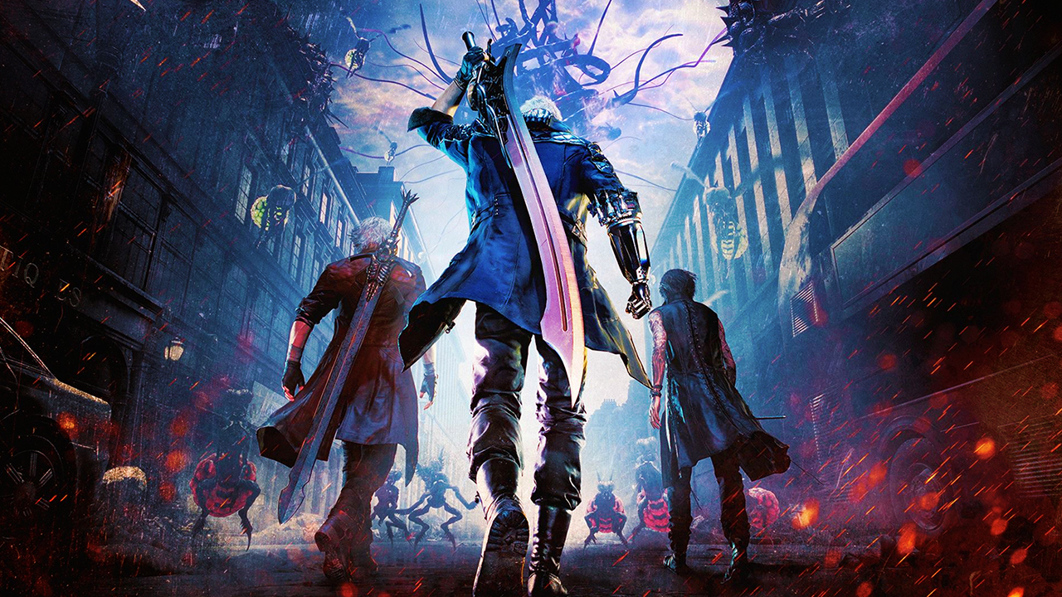
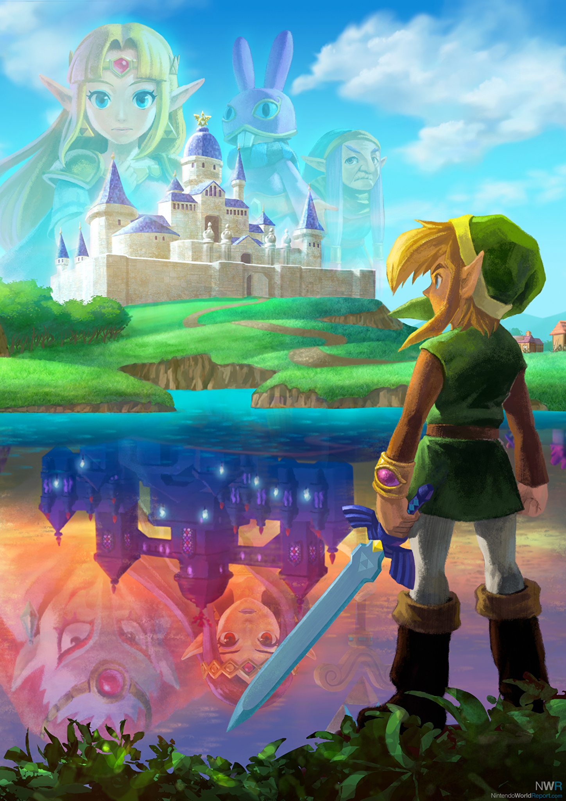

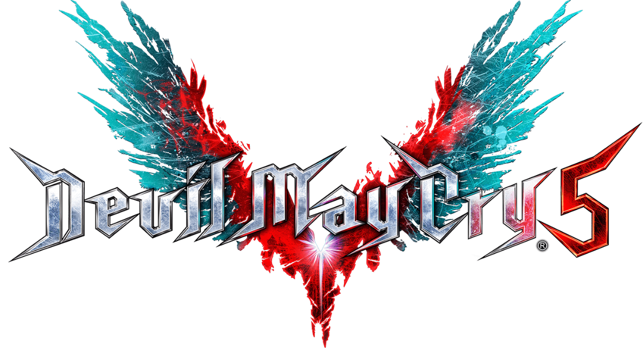
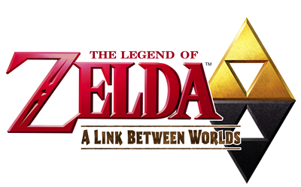

0
Pitch
Pitch
Pitch
+
+

Slide 5

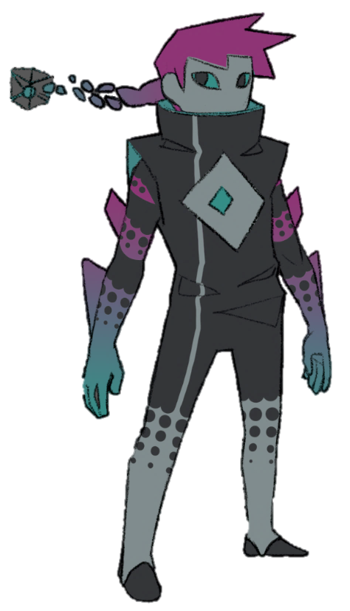
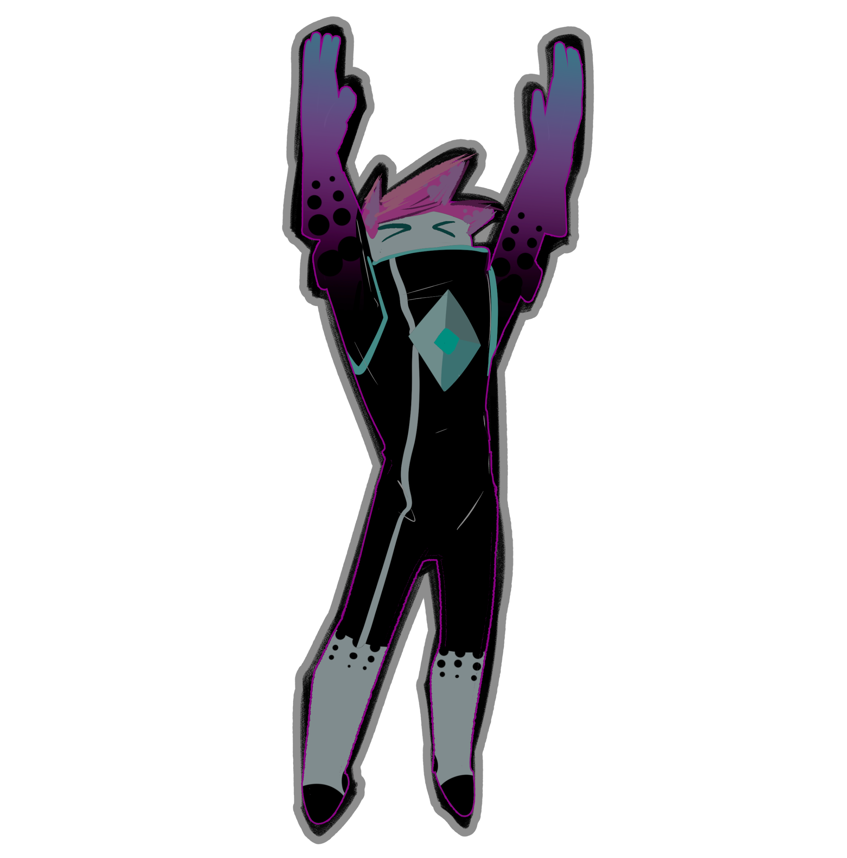
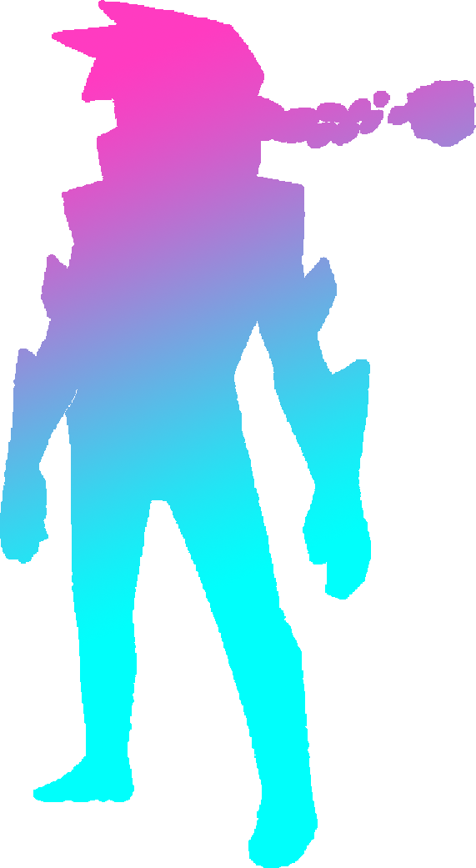

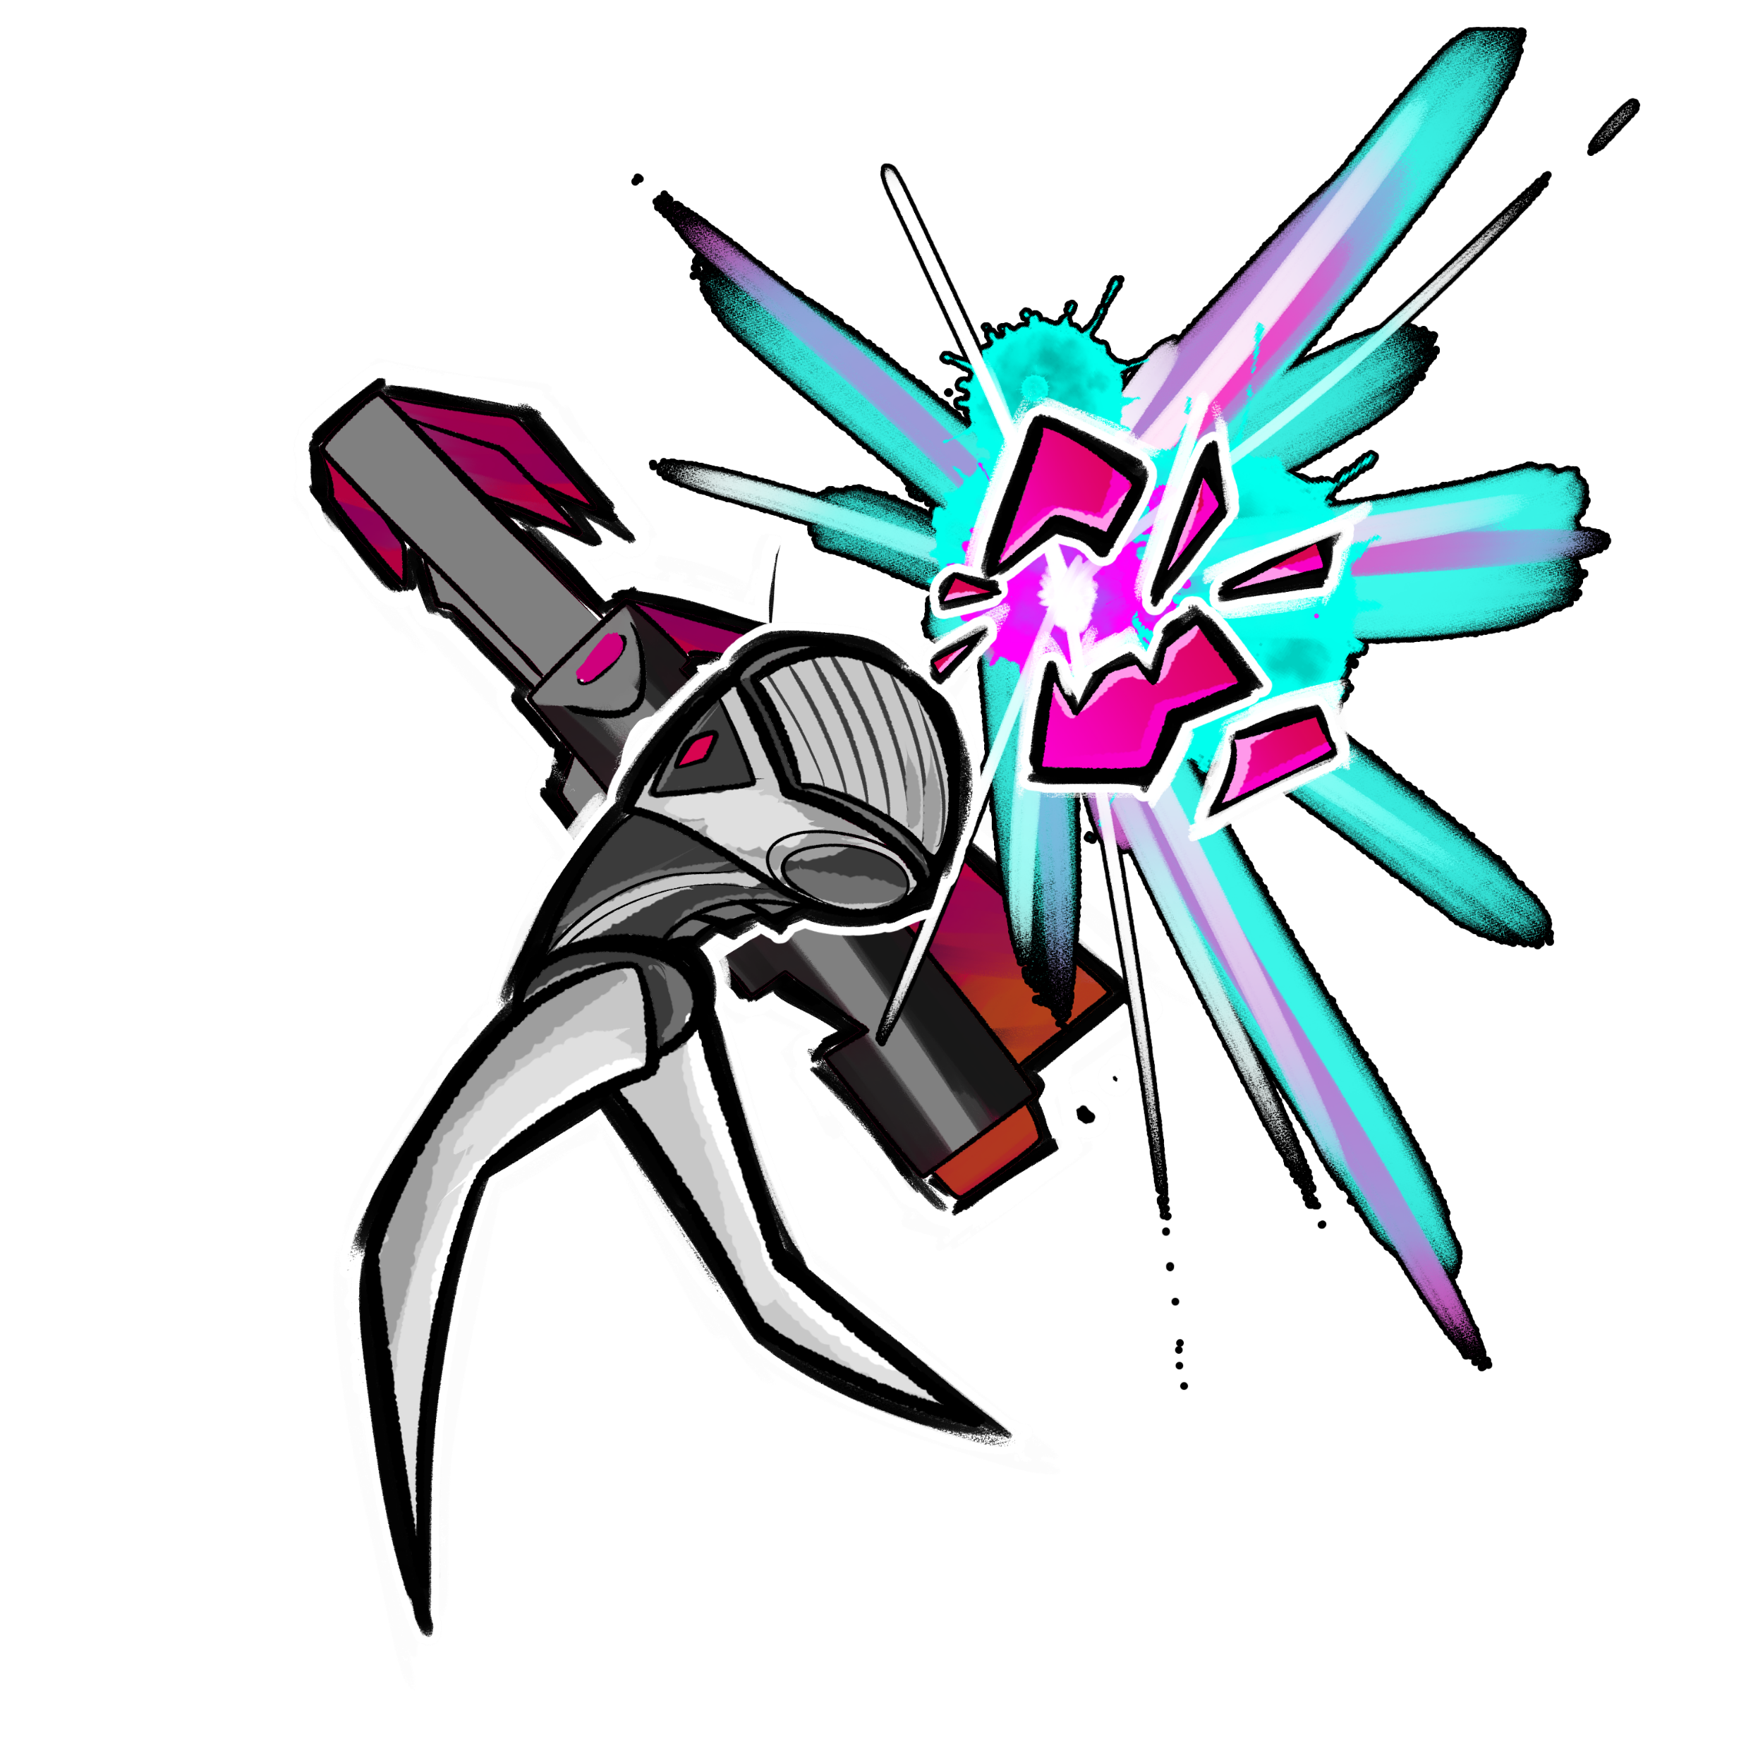
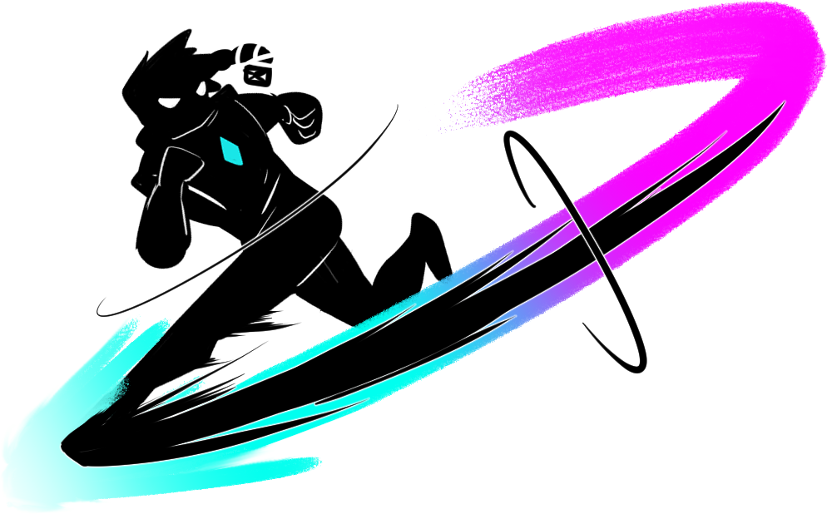
0
General Information
General Information
General Information
Single Player
Beat’em Up
Premium
Single Player
Beat’em Up
Premium
You play as the Manifold, during the invasion of Tesseria from Five Dimensional Beings, using their power over the dimensions to push back the invaders and prevent reality from collapsing.

Slide 6
Gameplay
Gameplay
Gameplay
Fun :)
Fun :)
Flow
Flow
Fast
Fast
Fast
Fast

Slide 7
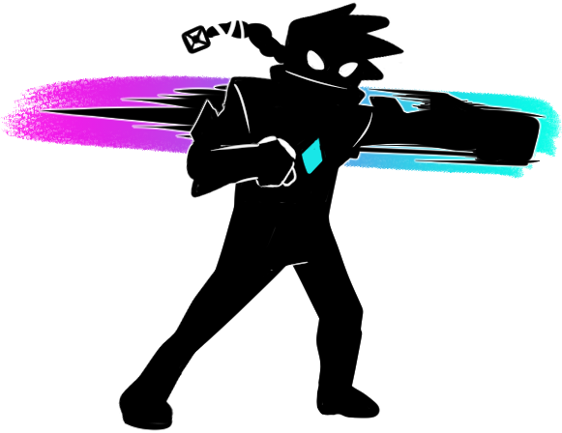
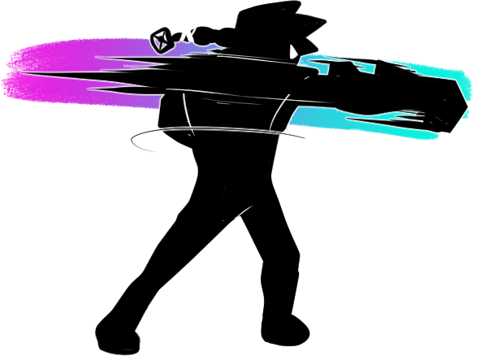
Gameplay
Gameplay
Gameplay
Image de gameplay
Flow
Flow
Image de gameplay

Slide 8
Gameplay
Gameplay
Gameplay
Image de gameplay
Fast
Fast
Fast
Fast
Image de gameplay

Slide 9
Gameplay
Gameplay
Gameplay
Image de gameplay
Fun :)
Fun :)
Image de gameplay

Slide 10
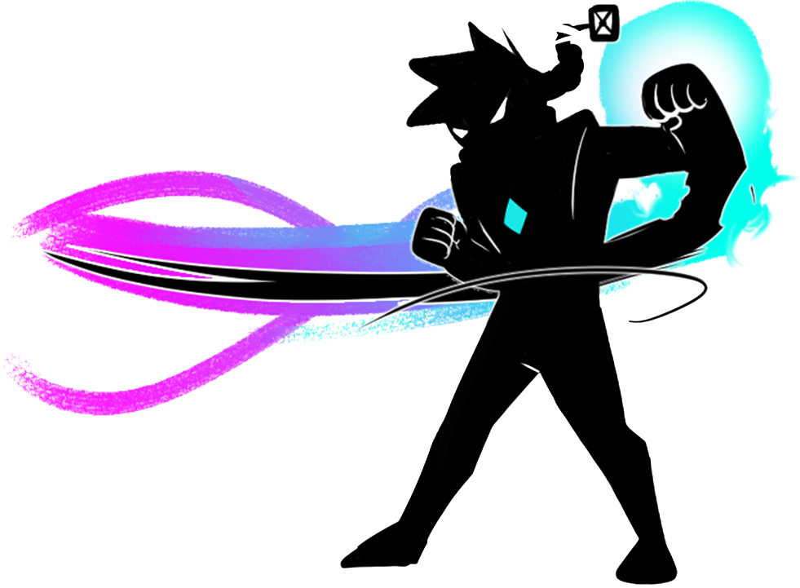

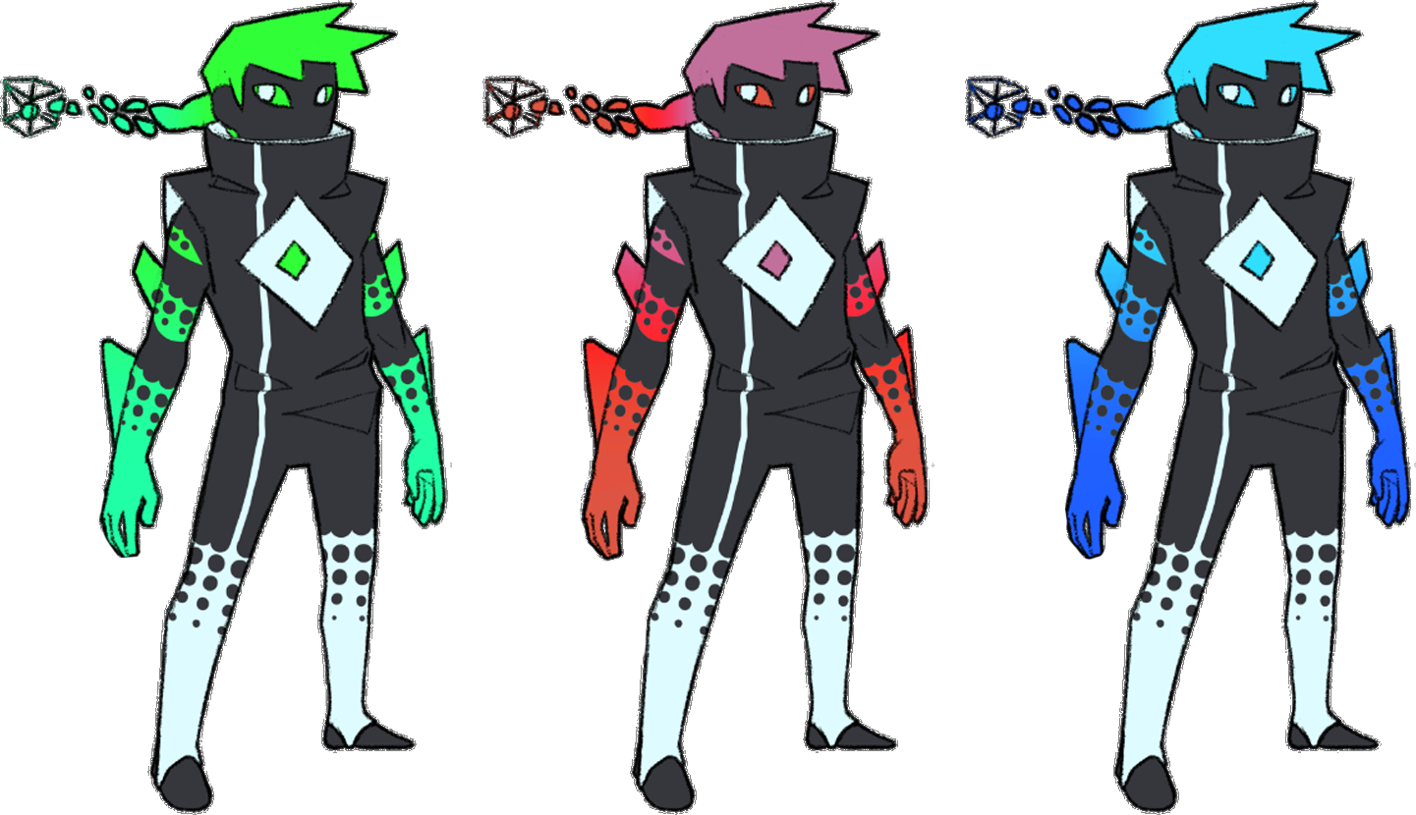


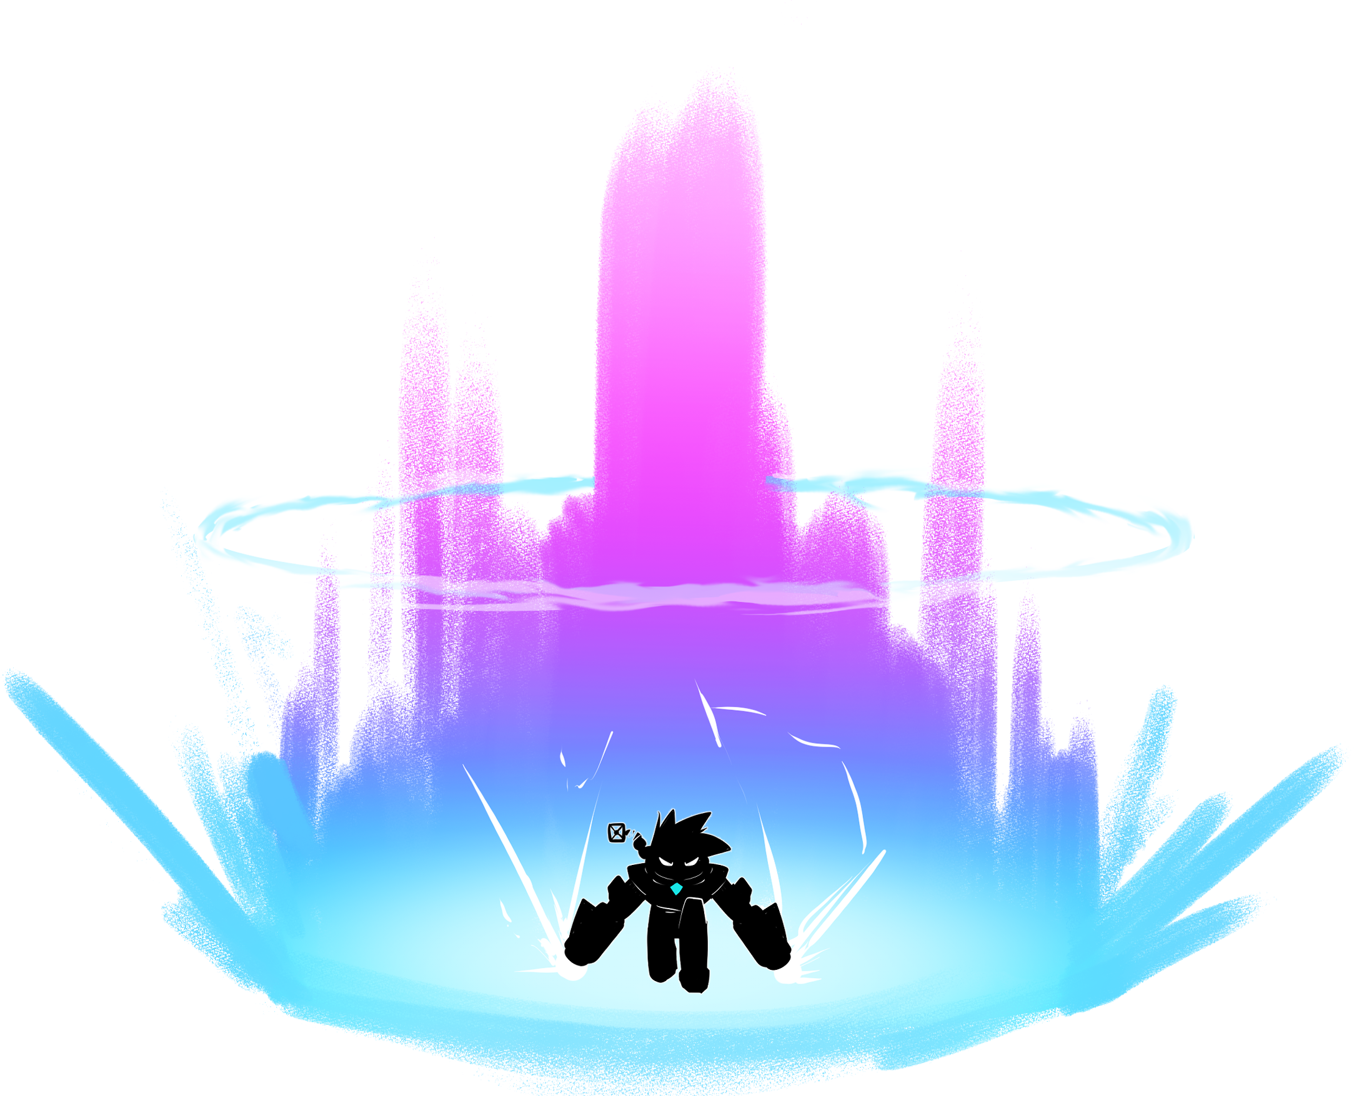
Gameloop
Gameloop
Gameloop
Fight
Platform
Loot
Customize
Collect
Unlock
Source Drain Trader

Slide 11
Mobile
High Contrast
Flat Color
Graffiti
Crystals
Cell Shading
Non-Euclidian
Body Shape
Textures
2D
Moodboards: Characters

Slide 12
Mobile
High Contrast
Flat Color
Graffiti
Crystals
Cell Shading
Non-Euclidian
Moodboards: Characters

Slide 13
Mobile
High Contrast
Flat Color
Graffiti
Crystals
Cell Shading
Non-Euclidian
Moodboards: Environment

Slide 14
Mobile
High Contrast
Flat Color
Graffiti
Crystals
Cell Shading
Non-Euclidian

Slide 15
Concepts
Concepts
Concepts

Slide 16
Level Design
Level Design
Level Design

Slide 17
Credits
Credits
Credits

Slide 18
MERSSI DAVOIRE REGARDÉ LA PREZ

